Slide 1

Graph Data Structure
A graph data structure is a collection of nodes that have data and are connected to other nodes.

Slide 2
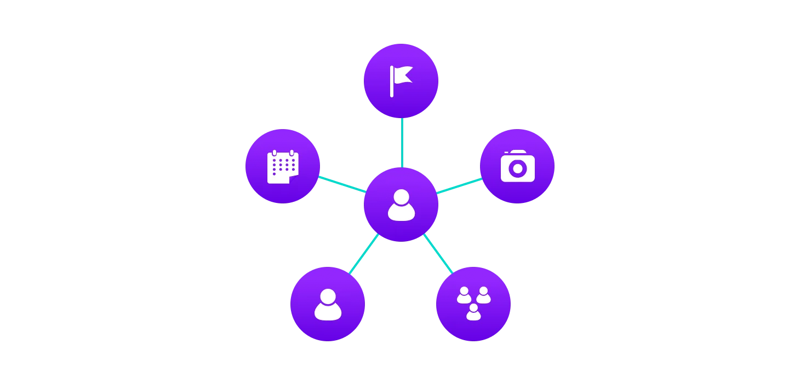
What is Graph Data Structure ?
Let's try to understand this through an example. On facebook, everything is a node. That includes User, Photo, Album, Event, Group, Page, Comment, Story, Video, Link, Note...anything that has data is a node.
Every relationship is an edge from one node to another. Whether you post a photo, join a group, like a page, etc., a new edge is created for that relationship.

Slide 3
Apply
All of facebook is then a collection of these nodes and edges. This is because facebook uses a graph data structure to store its data.
More precisely, a graph is a data structure (V, E) that consists of
A collection of vertices V
A collection of edges E

Slide 4

V = {0, 1, 2, 3}
E = {(0,1), (0,2), (0,3), (1,2)}
G = {V, E}

Slide 5
Spanning Tree and Minimum Spanning Tree
In this tutorial, you will learn about spanning tree and minimum spanning tree with help of examples and figures.
Before we learn about spanning trees, we need to understand two graphs: undirected graphs and connected graphs.

Slide 6
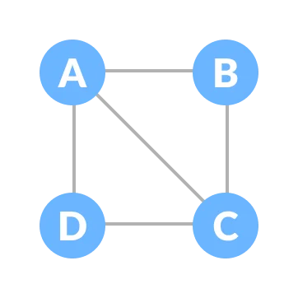
An undirected graph is a graph in which the edges do not point in any direction (ie. the edges are bidirectional).

Slide 7
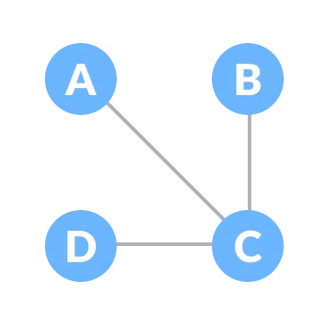
A connected graph is a graph in which there is always a path from a vertex to any other vertex.

Slide 8
Spanning tree
A spanning tree is a sub-graph of an undirected connected graph, which includes all the vertices of the graph with a minimum possible number of edges. If a vertex is missed, then it is not a spanning tree.

Slide 9
The total number of spanning trees with
n vertices that can be created from
a complete graph is equal to n^{(n-2).}
If we have n = 4, the maximum number of possible spanning trees
is equal to 4⁴⁻² = 16.Thus, 16 spanning trees can be formed from
a complete graph with 4 vertices.

Slide 10
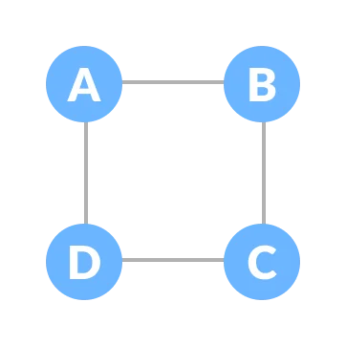
Example of a Spanning Tree
Let's understand the spanning tree with examples below:

Slide 11
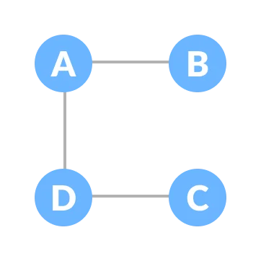
Some of the possible spanning trees that can be created from the above graph are:

Slide 12
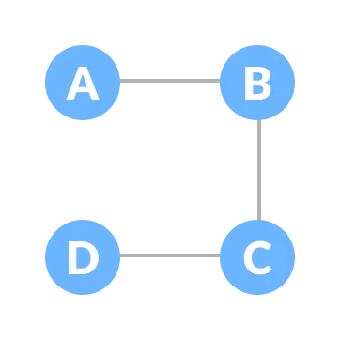
Some of the possible spanning trees that can be created from the above graph are:

Slide 13
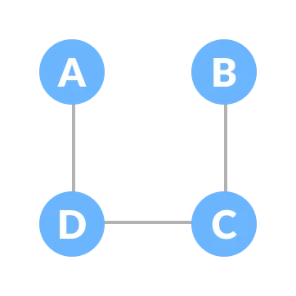
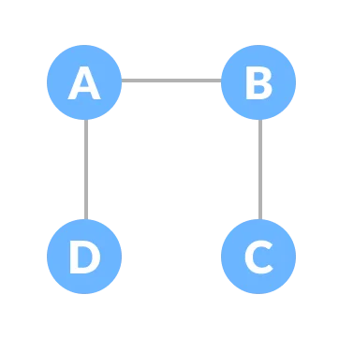
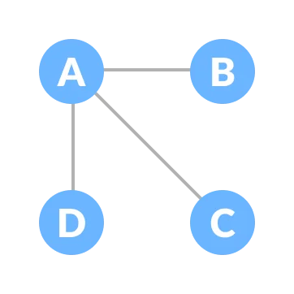
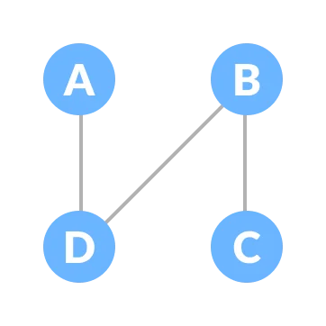

Slide 14
Minimum Spanning Tree(minimum weight spanning tree)
A minimum spanning tree is a spanning tree in which the sum of the weight of the edges is as minimum as possible.

Slide 15
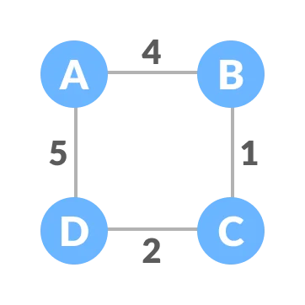
The initial graph is: (Weighted Graph)

Slide 16
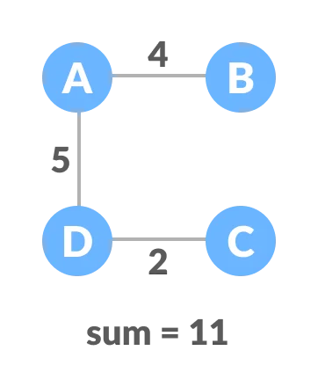
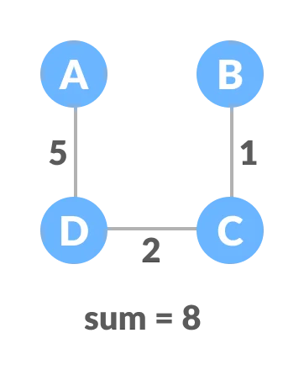
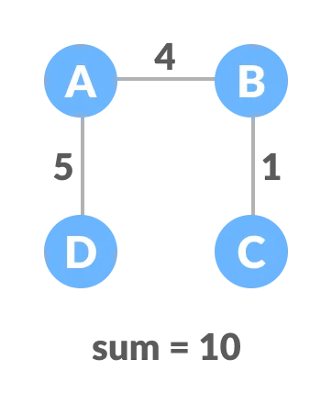
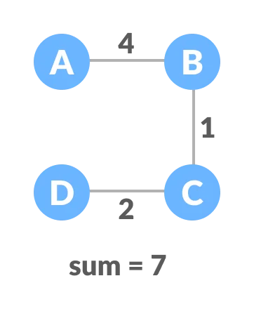
The possible spanning trees from the above graph are:

Slide 17
The minimum spanning tree from the above spanning trees is:

Slide 18
Spanning Tree Applications
Computer Network Routing Protocol
Cluster Analysis
Civil Network Planning

Slide 19
Minimum Spanning tree Applications
To find paths in the map
To design networks like telecommunication networks, water supply networks, and electrical grids.

